Slide 1
Requirements Acquisition
Tool
Team : 6
Members: Nabilahmed Patel
Shet Prajval
Tejaswini Mariyada
Limeng Shen
Wenbo Hu
Ashutosh Singh

Slide 2
Requirements
Constraints:
C.1 The RAT must be programmed in JAVA.
C.2 The RAT must be platform independent.
Requirements:
R.1 The RAT must provide a graphical user interface (GUI) to input the description and display the output.
R.1.1 The RAT must provide an input text-area for the user to input the description.
R.1.1.1 The user shall import description file into input text-area by clicking on “import” button.
R.1.1.2 The user shall enter description in input-text area manually by writing.
R.1.1.3 The user can edit the description in the input text-area.

Slide 3
Requirements
R.2 The RAT must have facility for user to identify Business Process, Steps and Actions.
R.2.1 User must be able to highlight verb-noun phrases manually.
R.2.2 User must be able to highlight verb-noun phrases automatically by clicking on “Highlight” Button.
R.2.3 User must be able to identify Business Process, Steps and Actions from highlighted verb-noun phrases.
R.2.4 RAT must have facility for user to provide other information related to business process in form of dialog box.
R.2.5 RAT must provide output text-area to display the generated requirements.
R.2.5 RAT shall display the identified business processes in the output text-area.

Slide 4
Requirements
R.3 User must be able to generate the requirements from identified business process.
R.3.1 RAT shall provide the “Generate” Button for user to click and generate the requirements.
R.3.2 RAT must generate the requirements from the information provided by the user and the identified business process.
R.4 RAT must provide output text-area to display the generated requirements.
R.4.1 RAT must display the generated requirements in the output text-area.

Slide 5
Requirements
R.5 RAT must provide the facility for user to edit the identified business process.
User must be able to edit and delete the identified business process.
RAT shall display the edited business process in the output text-area.
R.6 RAT shall provide the facility to export/save the generated requirements in the form of document.
R.6.1 RAT shall provide an “Save” button to export generated requirements into file.

Slide 6
Use Case Modelling
Abstract Use Cases:
UC1: Input Description(Actor: User, System: RAT)
UC2: Identify Business Process, Steps and Actions(Actor: User, System: RAT)
UC3: Generate Requirements(Actor: User, System: RAT)
UC4: Edit Business Process(Actor: User, System: RAT)
UC5: Export Requirements(Actor: User, System: RAT)

Slide 7
Use Case Modelling
High Level Use Cases:
UC1: Input Description
TUCBW The user clicks on the import button or places the cursor on the textbox.
TUCEW The user imports a file or types in the description manually as the input.
UC2: Identify Business Process, Steps and Actions
TUCBW The user clicks on the highlight button.
TUCEW The user classifies into business processes, steps and actions.
UC3: Generate Requirements
TUCBW The user clicks on the generate button.
TUCEW The user views the generated requirements.

Slide 8
Use Case Modelling
High Level Use Cases:
UC4: Edit Business Process
TUCBW The user clicks on the text and edits it.
TUCEW The user sees the edited requirements.
UC5: Export Requirements
TUCBW The user clicks on the export button.
TUCEW The user gets a saved file.

Slide 9
Use Case Modelling
Expanded Use Cases:
UC1: Identify Business Processes Manually
Actor: User | System: RAT
 | 0. System displays the GUI.
1. TUCBW user inputs the description. | 2. System shows the description in the input text-area.
3. User repeatedly selects verb-noun phrases and identifies as business process. | 4. System pops-up the corresponding dialog-box.
5. User inputs the business process, steps, actions and priorities into the dialog-box. | 6. System stores business processes in list and displays in the output text-area.
7. TUCEW user sees the identified business processes.

Slide 10
Use Case Modelling
Expanded Use Cases:
UC2: Edit Business Processes
Actor: User | System: RAT
 | 0. The System displays the identified business processes in the output text-area.
1. TUCBW user right clicks on the identified business process. | 2. The system pops-up menu.
3. The user selects the edit or delete option from the menu. | 4. The system pops-up the dialog-box for corresponding business process.
5. The user repeatedly edits business processes of output text-area. | 6. System makes relevant changes into the list and output text-area.
7. TUCEW the user sees business process is successfully edited.

Slide 11
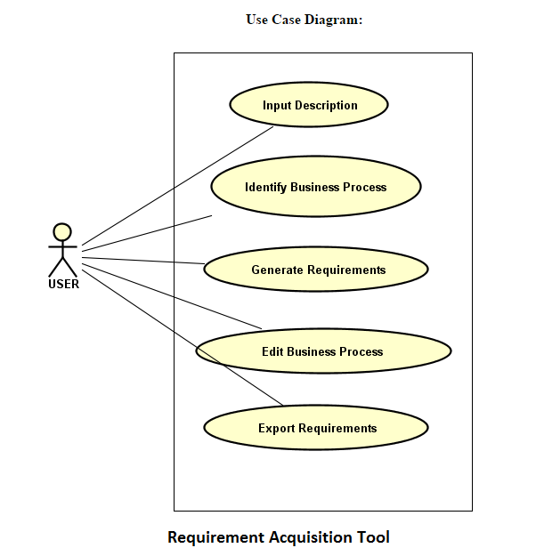
Use Case Modelling

Slide 12
Use Case Modelling
Requirement-UseCase Tracibility Matrix:
Requirement ID | Is this a business process? | Does it begin with an actor? | Does it end with an actor? | Does it accomplish a business task for the actor? | Is it a use case? | Actor | Subsystem
R.1 | Y | Y | Y | Y | Y | user | RAT
R.2 | Y | Y | Y | Y | Y | user | RAT
R.3 | Y | Y | Y | Y | Y | user | RAT
R.4 | N | N | N | N | N | NA | RAT
R.5 | Y | Y | Y | Y | Y | user | RAT
R.6 | N | Y | N | N | N | user | RAT

Slide 13
Domain Modelling
Brainstorming:
Domain Information of Requirement Acquisition
A user is given³ the textual⁴ description¹. A user¹ is able to edit³ the description. The verb-noun phrases¹ are identified³ by the user from the given description. The identified verb-noun phrases are categorized³ into business processes¹, steps¹ and actions¹. The business process consists of steps⁷,and the step consists of actions⁷.The requirements¹ are generated³ from categorized business processes , steps and actions . The generated requirements are in an ordered⁴ format¹. The requirements are saved³ by the user.

Slide 14
Domain Modelling
Classification:
Brainstorming List | Classification Result | Rule
description¹ | (C) Description | 1(a)
requirement¹ | (C) Requirement | 1(a)
given³ | (AS) given ( user, description) | 3
textual⁴ | (V) textual | 4
user¹ | (C) User | 1(a)
edit³ | (AS) edit (user, description) | 3
identify³ | (AS) identify (user, verb-noun phrase) | 3
verb-noun phrase¹ | (C) Verb-Noun Phrase | 1(a)
business processe¹ | (C) Business Process | 1(a)
step¹ | (C) Step | 1(a)

Slide 15
Domain Modelling
Classification:
Brainstorming List | Classification Result | Rule
action¹ | (C) Action | 1(a)
generated³ | (AS) generated (business processes, requirements) | 3
generated³ | (AS) generated (steps, requirements) | 3
generated³ | (AS) generated (actions, requirements) | 3
process consists of⁷ | (AG) consists of (business process, steps) | 7
steps consists of⁷ | (AG)consists of (steps, actions) | 7
ordered⁴ | (V) ordered | 4
format¹ | (A) format | 1(e)
save³ | (AS) save (user, requirements) | 3

Slide 16
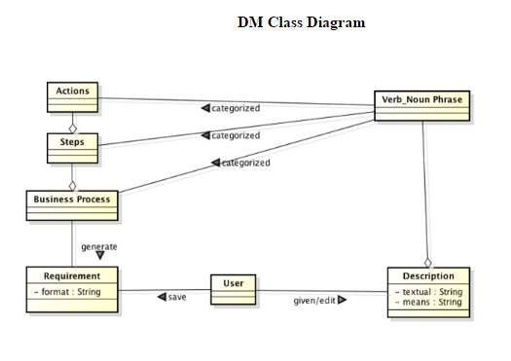
Domain Modelling

Slide 17
Object Interaction Modelling
Scenario
UC1: Identify Business Processes Manually
5. 6. 6.1 6.1.1 6.1.2 6.1.2.1 6.1.2.2 6.1.3 6.1.4 6.1.5 6.2 | User inputs the business processes, steps, actions and priorities from the dialog-box. The GUI sends the business processes and the parameters including steps, actions, priorities to BPController. For each business process, The BPController creates BusinessProcess object using business process. For each parameter, BPController creates the Object or attribute of corresponding Parameter. BPController adds parameter Object or attribute into BusinessProcess Object. The BPController sends the BusinessProcess object to StoreMgr. The StoreMgr saves the BusinessProcess object in List. The BPController sends the BusinessProcess object in string format to the GUI. GUI displays the business processes in the output text-area.

Slide 18
Object Interaction Modelling
ScenarioTable:
# | Subject | Subject action | Other data/Objects | Object Acted Upon
5. | User | inputs | business processes,steps,actions and priorities | GUI
6 | GUI | sends | business processes and parameters | BPController
6.1 | For each business process
6.1.1 | BPController | creates | busineess process | Business process object
6.1.3 | For each parameter
6.1.3.1 | BPController | creates | parameter | Object or attribute
6.1.3.2 | BPController | adds | Object or attribute | BusinessProcess Object
6.1.4 | BPController | sends | Business Process Object | StoreMgr
6.1.5 | StoreMgr | saves | Business Process Object | List
6.1.6 | BPController | sends | Business Process Object | GUI
6.2 | GUI | displays | business process | output text-area

Slide 19
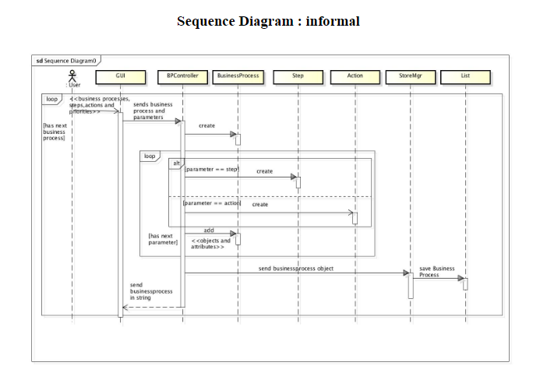
Object Interaction Modelling

Slide 20
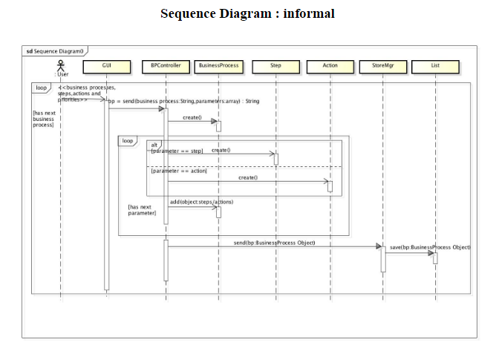
Object Interaction Modelling

Slide 21
Object Interaction Modelling
Scenario
UC2: Edit Business Processes
3. 4.1 4.2 4.2.1 4.2.2 4.2.2.1 4.2.3 4.2.3.1 4.2.3.2 4.2.3.1.1 4.2.3.1.2 4.2.3.3 4.2.3.4 4.2.3.5 4.3 | The User edits the business processes of output text-area. The GUI sends the business processes and the parameters including steps, actions, priorities to the BPController. For each business process, The BPController sends the business process and action to StoreMgr. If action is delete, StoreMgr removes BusinessProcess object for business process. If action is edit, StoreMgr sends BusinessProcess object for business process to BPController. For each parameter, BPController edits the Object or attribute of corresponding Parameter BPController edits parameter Object or attribute into BusinessProcess Object. The BPController sends the BusinessProcess object to StoreMgr. The StoreMgr saves the BusinessProcess object in List. The BPController sends the BusinessProcess object in string format to the GUI. GUI displays the edited business processes in the output text-area.

Slide 22
Object Interaction Modelling
ScenarioTable:
# | Subject | Subject action | Other data/Objects | Object Acted Upon
4. | User | edits | output text-area | Business processes
4.1 | GUI | sends | business processes and parameters | BPController
4.2 | For each business process
4.2.1 | BPController | sends | Business processes, action | StoreMgr
4.2.2 | If the action is delete
4.2.2.1 | StoreMgr | removes | Business Process object | List
4.2.3 | If the action is a edit
4.2.3.1 | StoreMgr | sends | Business Process object | BPController
4.2.3.2 | For each parameter
4.2.3.2.1 | BPController | edits | parameter | Object or attribute
4.2.3.2.2 | BPController | edits | Object or attribute | BusinessProcess Object

Slide 23
Object Interaction Modelling
ScenarioTable (Cont.)
# | Subject | Subject action | Other data/Objects | Object Acted Upon
4.2.3.2 | BPController | sends | Business Process Object | StoreMgr
4.2.3.4 | StoreMgr | saves | Business Process Object | List
4.2.3.5 | BPController | sends | Business Process Object | GUI
4.3 | GUI | displays | business process | output text-area

Slide 24
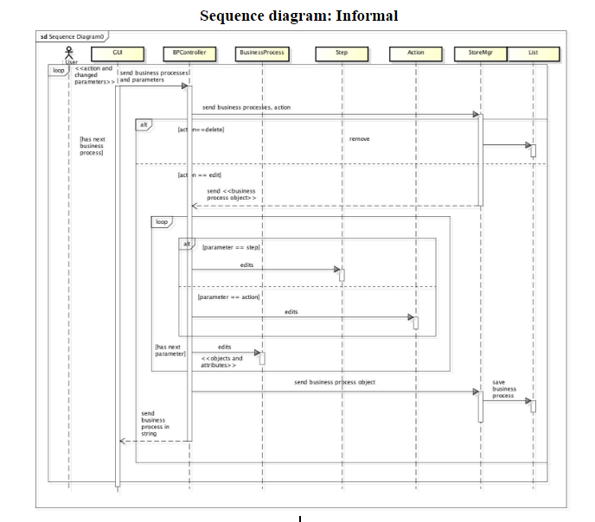
Object Interaction Modelling

Slide 25
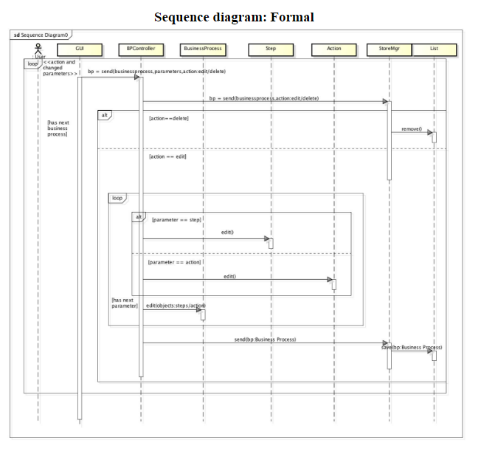
Object Interaction Modelling

Slide 26
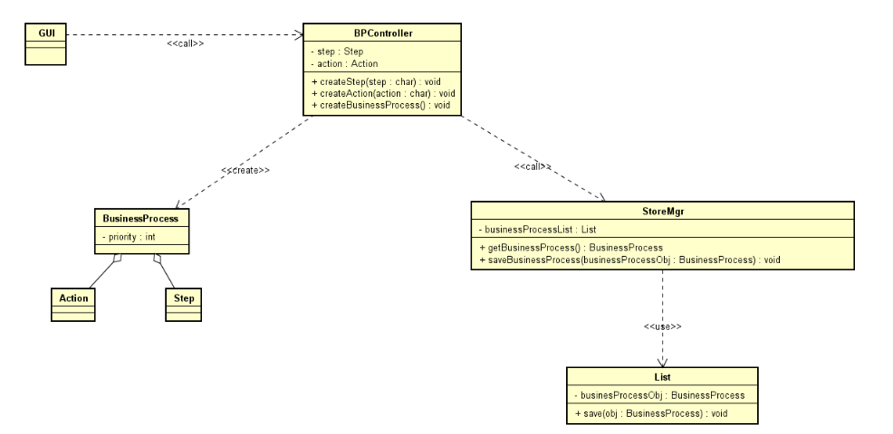
Design Class Diagram

Slide 27
THANK YOU

